Slide 1
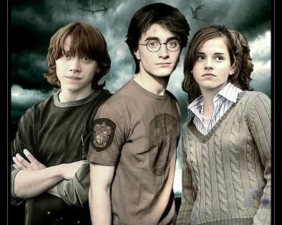
Harry Potter and the
Recessive Allele
How Are Wizards Made?

Slide 2
How Are Wizards Made?
Being a wizard or a muggle is all decided by genetics
All humans including wizards receive one allele from each parent

Slide 3
How Are Wizards Made?
The allele for wizarding ability is m
Wizards have the alleles mm

Slide 4
How Are Wizards Made?
The allele for muggleness is M
Muggles have the alleles Mm or MM
M is dominant to m so you can only be a wizard if you have no M allele

Slide 5
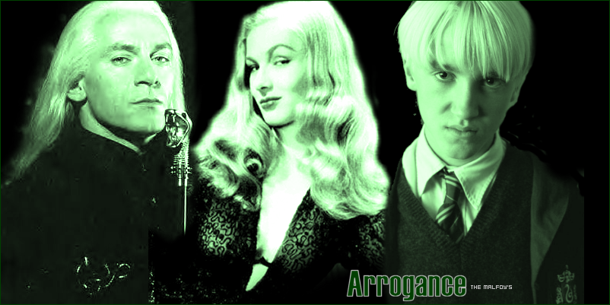
The Malfoys
Lucius Malfoy (mm)
Narcissa Malfoy (mm)
Draco Malfoy
( )
m
m
The Malfoys are a ‘pure blood’ family
All their ancestors are wizards so they must have the alleles mm

Slide 6
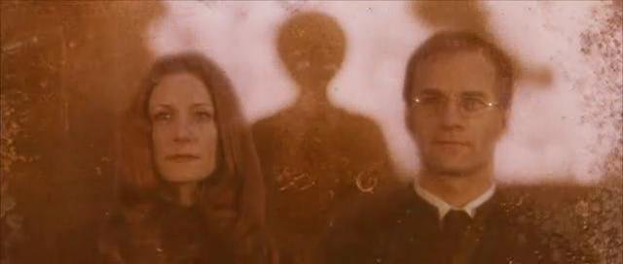
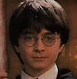
The Potters
Lily Potter (mm)
James Potter (mm)
Harry Potter
(WW)
m
m
Both Harry’s parents had magical ability so they must both have been mm
They passed these alleles on to Harry

Slide 7
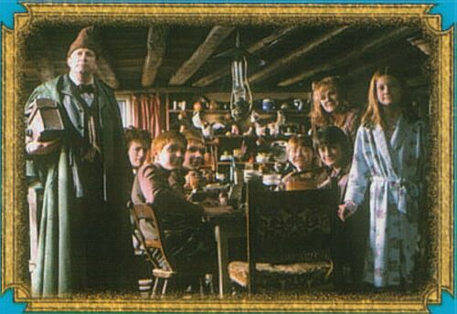
The Weasleys are pure blood wizards so they all have the alleles mm

Slide 8
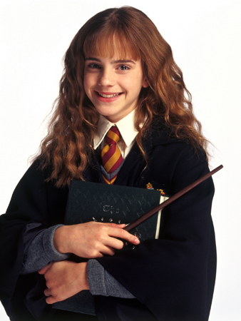
Hermione is a powerful witch so she must be mm
Both her parents are muggles so they must be Mm so they can give her a m allele each
Mm
Mm
mm

Slide 9
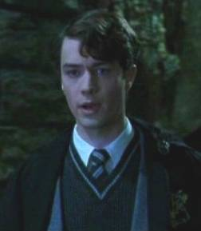
Tom Riddle is a ‘half blood’.
His mother was a witch (mm) and his father was a muggle
His father must have had the alleles Mm so he could give him the other m allele
mm
Mm
mm

Slide 10
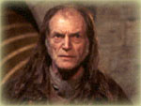
Filch is a ‘squib’
Both his parents are mm so he should be too because he can’t get an M allele from either parent but he can’t do any magic
This means he has a mutation so his wizarding powers don’t work or the man he thinks is his father isn’t really and his mother had an affair with a muggle!

Slide 11
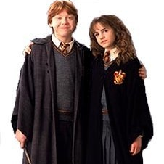
What wizarding alleles would Ron and Hermione’s children have?
Ron (mm)
Hermione (mm)
Children
( )
m
m

Slide 12
Their children could only get the m allele from both parents so they would all be wizards
 |  | Ron
 |  | m | m
Hermione | m
 | m
m
m
m
m
m
m
m
m

Slide 13

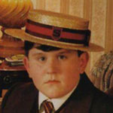
What wizarding alleles would Ginny and Dudley’s children have?
If Dudley is Mm
Ginny mm
Children
WW or mM
Dudley Mm
M
m
m
m

Slide 14
Half of their children would be likely to get the m allele from both parents so they would be wizards
The other half would be likely to get an M allele from Dudley and would be muggles
 |  | Dudley
 |  | m | M
Ginny | m
 | m
m
m
M
m
m
M
m
m

Slide 15
What wizarding alleles would Ginny and Dudley’s children have?
If Dudley is MM
Ginny mm
Children
WM
Dudley MM
M
m

Slide 16
Their children would get the m allele from Ginny and the M allele from Dudley so they would all be muggles
 |  | Dudley
 |  | M | M
Ginny | m | WM | WM
 | m | WM | WM
M
M
m
m
M
M
m
m

Slide 17
What wizarding alleles would you
expect Hermione’s
brothers and sisters to have?

Slide 18
The Granger’s children have a one in four chance of getting m alleles from both parents and having magical ability
They also have a one in four chance of getting M alleles from both parents and being a muggle
They could also
get only one
m from their
mother or father
and still be a
muggle
 |  | Mr Granger
 |  | m | M
Mrs Granger | m | WW | WM
 | M | WM | MM
m
m
M
m
M
M
M
m

